Slide 1

A fashion show & survey Project
You are going to have a fashion show.
A. Make notes. Work with a partner. What clothes, shoes, and accessories is your partner wearing? Make a list.
B. Have a fashion show. Join other pairs to make a group of six. Your group is going to have a fashion show. Each pair in the group does this:
Person A: Stand and walk around.
Person B: What is your partner wearing? Tell the group.
Other students: Say something nice about the clothes the person is wearing. Change roles and repeat.

Slide 2
A fashion show & survey Project
C. Make a list. What clothing, colors, and accessories are the most common in your group? Make a list and write your answers on the board.
D. Discuss in groups. Answer these questions.
Read the answers on the board. In your class, what styles are most popular?
What do you think of these styles? Do you like them? Why or why not?

Slide 3
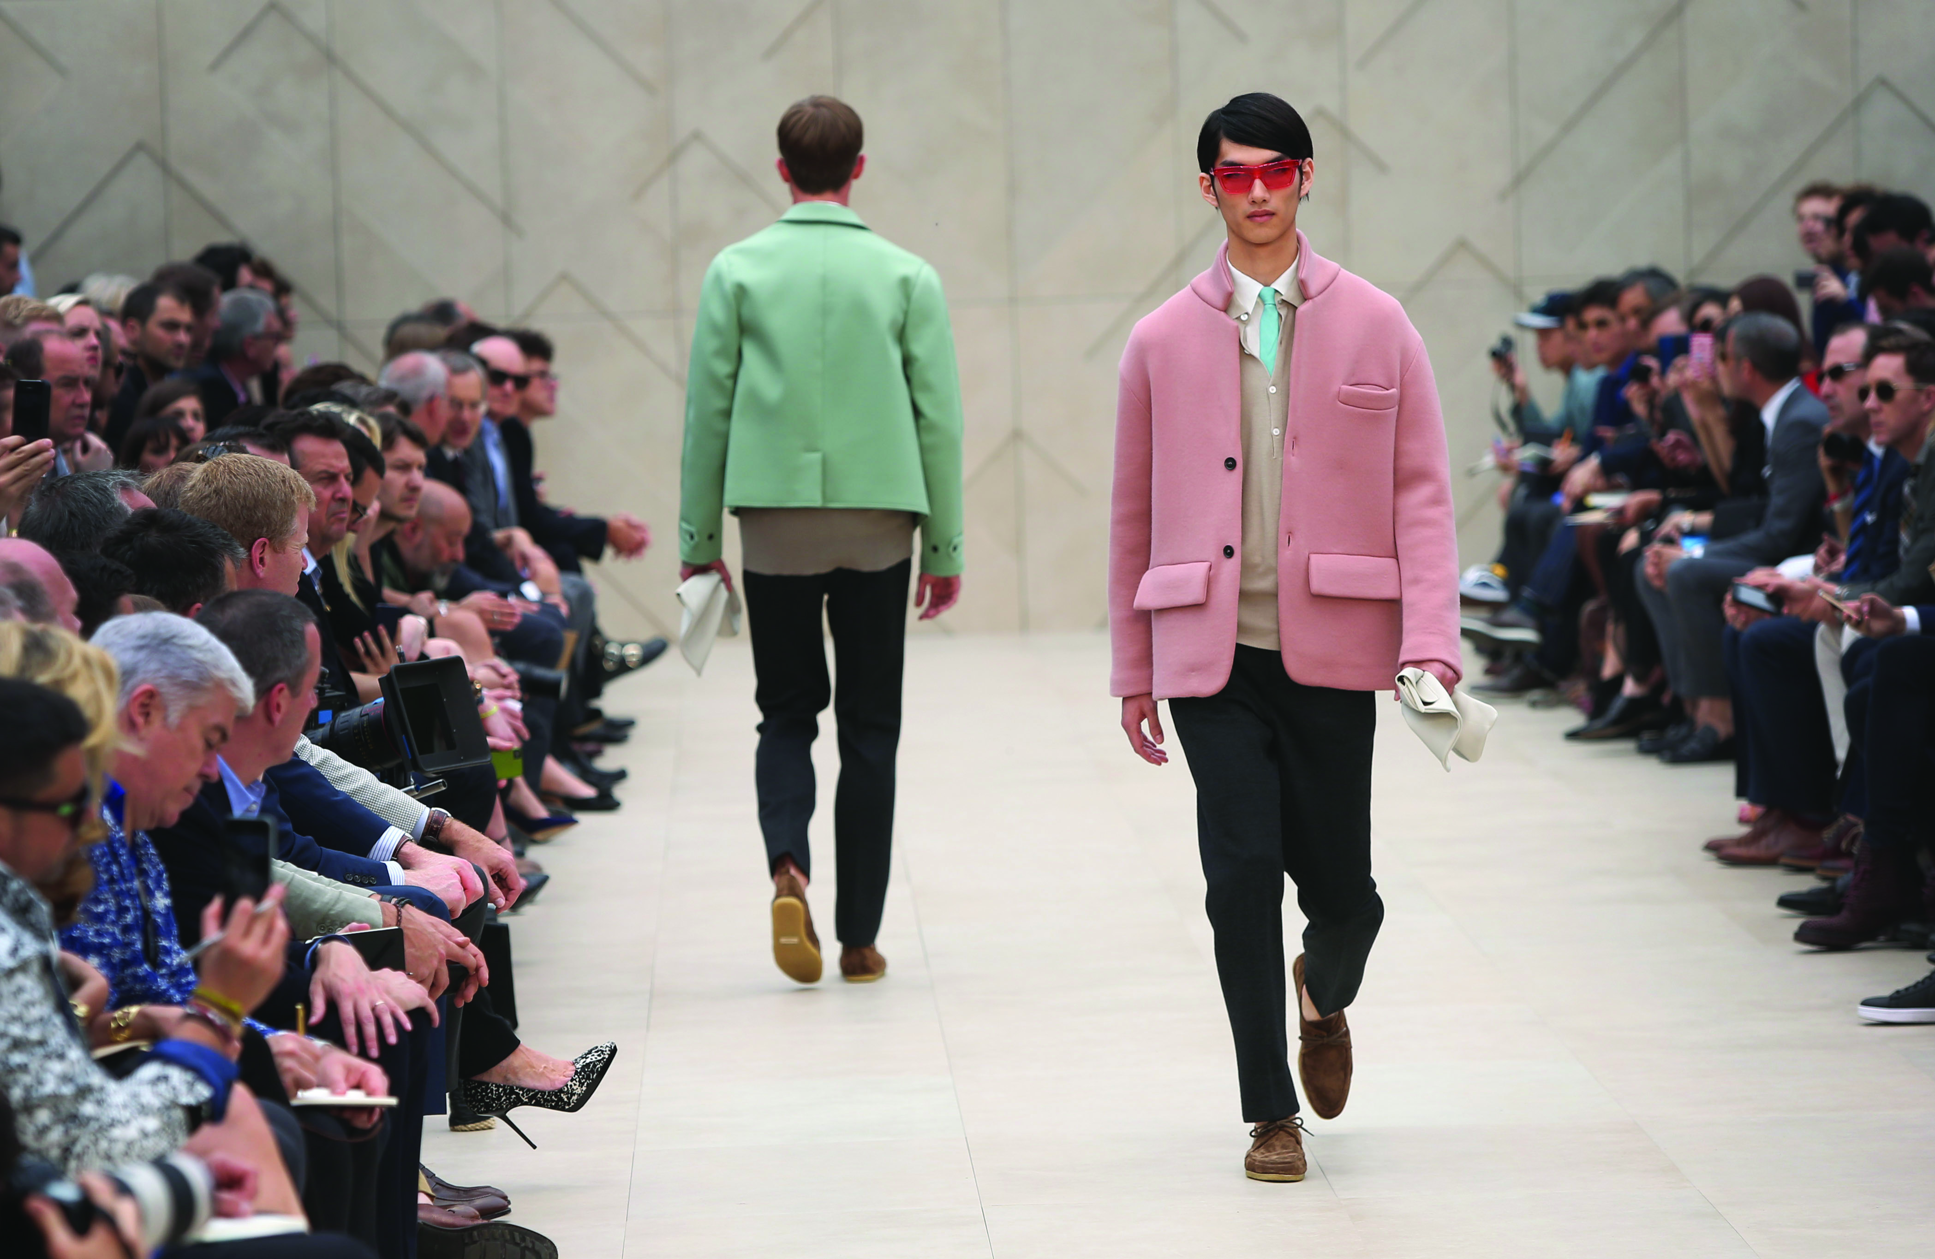
A fashion show & survey Project
Keep a research diary. Observe the people around you—people in coffee shops, people on the train, and people in shops. Look at what they are wearing. Keep a diary. What clothing and clothing accessories are the most common? Share your findings with the class.
Models at a fashion
show in London, U.K.

